Slide 1









SUBITO trial
24-11-2022

Slide 2
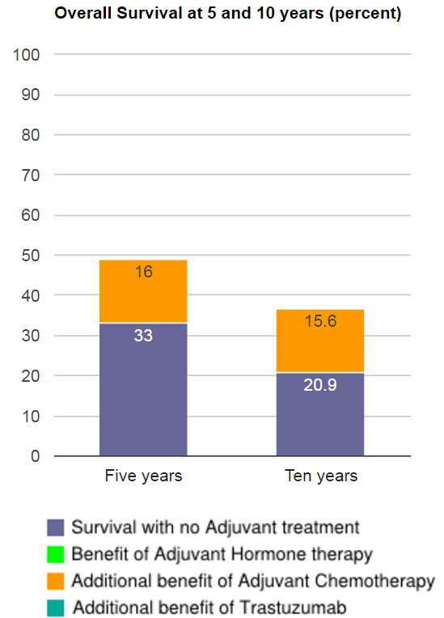
SUBITO trial
Woman, 40 years old
Tumour 5cm, right breast
Triple negative, grade 3
Stage III disease (8 axillary lymph nodes)
±60 / 100 deaths, despite being treated
http://www.predict.nhs.uk/predict_v2.0.html

Slide 3
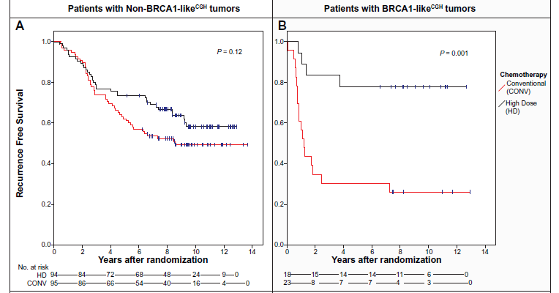
SUBITO
Substantially improving the cure-rate of
high risk BRCA1-like breast cancer

Slide 4
SUBITO study design
pCR
1 year olaparib
ER/PgR pos:
≥ 5 years Htx
Arm A
1 x ddAC + 4 x CP
Non pCR:
8x capecitabine
1 year olaparib
ER/PgR pos:
≥ 5 years Htx
R^
Surgery and if indicated radiotherapy
HRD+
pCR
ER/PgR pos:
≥ 5 years Htx
Arm B
1 x ddAC followed by 2 x mCTC + PSCT
Stage III, HER2-negative breast cancer
Non pCR:
8 x capecitabine
3x ddAC#
& HRD test
ER/PgR pos:
≥ 5 years Htx
HRD-
Standard of care
Usual care

Slide 5
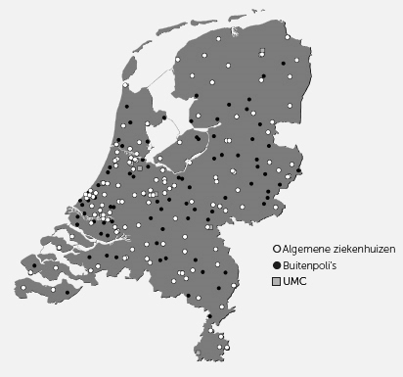

SUBITO
Participating sites
Hospitals open for inclusion
  AvL (januari 2017)
  EMC (februari 2017)
  UMCU (april 2017)
  UMCG (mei 2017)
  AUMC (oktober 2017)
  LUMC (november 2018)
  MUMC (januari 2018)
  MST (maart 2018)
  UMCN (juli 2018)
  IPC (Marseille) (maart 2021)

Slide 6
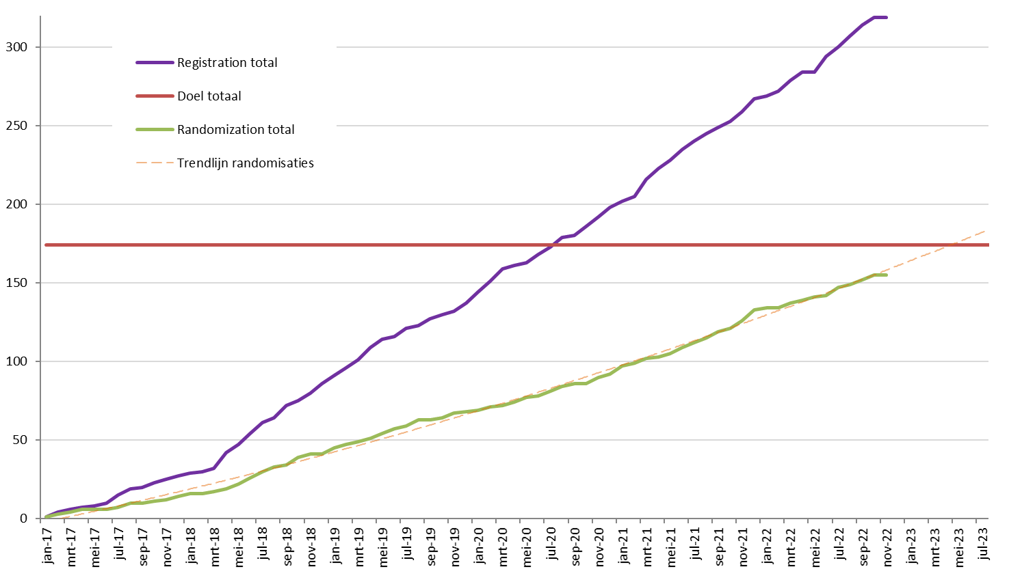
SUBITO
ACCRUAL UPDATE

Slide 7
SUBITO
QUALITY OF LIFE QUESTIONNAIRES
Registratie Randomisatie
Reden niet (volledig) ingevuld
Taalbarrière
Terugtrekking uit studie
Panel of questionnaires (papier) bleek bij aanvang studie onvolledig (wel: EQ-5D-5L)

Slide 8
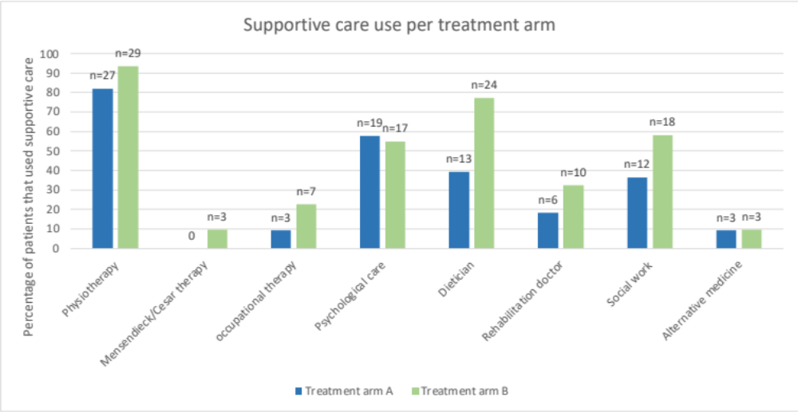
SUBITO
Supportive care use

Slide 9
SUBITO
2023
Datacleaning
Analysis supportive care use + Systematic review HDCT
Inclusion closed ± april
Side studies
± June: Database lock (med FU 36 mnd + 36 OS events)
Preliminaire analyse QoL
+ Costeffectiveness-analysis
±Sept/okt: Primary analysis and statistical rapport
Analysis side-studies
2024
Jan’24 ±100 pten QoL-3 en cognitie-2 → Analysis

Slide 10
SUBITO
Future plans
Translational research for better biomarkers
  Among others: ctDNA analysis, TIL scoring

